Slide 1
Status update

Slide 2
Things that I’ve done
Written on the parser pipeline until actions
In code, created action “ROTATE” (added all subjects)
Nearly done creating word embedding pipeline
Thought about training evaluation

Slide 3
Thesis feedback slide
Does not make sense to evaluate the full system, if you don’t evaluate each part.
Parser: evaluate only the parser
Evaluate word embeddings see if they fall into the same category
Make sure that all sections work separately. Show results

Slide 4
Feedback 2
Very wordy (be careful with language, don’t use ludicrously subjective words, like “ludicrously”, “boils down to”)
Diagrams could go along way. Describe using diagrams instead of text, as it makes it easier to read.
Do not use contractions (it’s)
Graphics write the authors and ask permission. Edit new one. (still make a reference)
Sometimes consider to not go chronologically, as it makes it hard to understand. Reverse chronologically order to have better idea what is going on. (tend to write chronologically)(Action parser, what actions needs to be done. Then analyse text). Start overview, dig down to all components, combine them together, show example output at the end.
Reverse chronological (parser): what actions is needed -> what does this require? (A, B, C), show example og A B and C.
Give a lot of examples, that’s good. (general problem by students, I lack overview.)
Referering to other chapters are good
Chapter 2, poof suddenly… neural networks! (Describes more what to do, instead of why im doing it.) Could be solved by using SOTA in introduction.

Slide 5
feedback
I need something between chapter 1 and 2, flip neural network and natural language chapter.
State of the art in the introduction?
Project scope
Thesis outline.
Comment: sometimes I make statements out of the blue, with no justification. They need justification.
NER: does not have anything about what it is. Only how I need to use it.
Define “softmax” as a function in mathmode.
Deleted: a vague statement, something in the lines of “may not be ”
“BERT is trained in a different way” gives zero information and adds vagueness for no reason.
Time complexity in LSTM, write as a table as it does not make sense without.

Slide 6
Code I created
For Rotate
NLP -> actions
Actions -> kinematics
Implemented
- All subjects (partial and full robot)
- optimized the “NLP to actions” pipeline (Handles actions with same verbs, verb “move” is both in ROTATE and MOVE action).

Slide 7
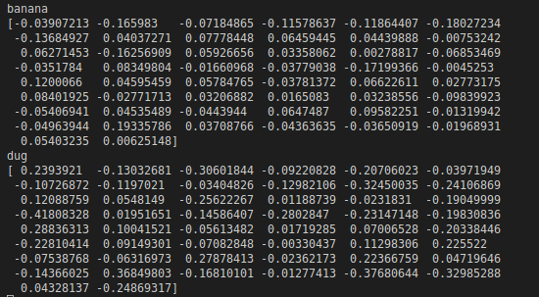
Word embedding
Works!

Slide 8
Word embedding
Works!
What now D: (Since I don’t know how to implement as similarity, then I haven’t evaluated it) there is a numpy dot product function

Slide 9
Training evaluation
Full system
NLP pipeline
Parser pipeline
kinematics

Slide 10
Training evaluation
Full system
Deterministic
Deterministic
NLP pipeline
Parser pipeline
kinematics

Slide 11
Training evaluation
Full system
Deterministic
Deterministic
NLP pipeline
Parser pipeline
kinematics
- Create a lot of default sentences for instructions (maybe from others to ensure that its natural language instructions)
- Run them through the pipeline and see if the correct intentions was created. (correct list of action sequences)

